Slide 1
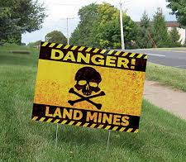
AVOIDING LANDMINES IN ARBITRATION CLAUSES
September 11, 2025
Andrew LeGrand, Jonathan Childers, and Brian Robison

Slide 2

OVERVIEW
Panelist introductions
Recent Developments in Arbitration Law
Nuclear Arbitration Clauses
Considerations in Drafting Arbitration Clauses
Watch Out for Waiver
Limited Appellate Review

Slide 3
RECENT DEVELOPMENTS IN ARBITRATION LAW
Mass arbitrations (Uber, Lyft, Door Dash, and Chipotle)
2024 Smith case – SCOTUS 9-0 ruling that a district court must stay a case after compelling arbitration
2024 Coinbase case – SCOTUS 9-0 ruling that courts must resolve disputes arising from competing arbitration clauses
2023 Coinbase case – a district court must stay a case if it denies a motion to compel arbitration and that decision is appealed
2025 Brooks v. Dwyer case – Houston First COA ruling highlights the difficulty in getting an arbitration award overturned on appeal

Slide 4
NUCLEAR ARBITRATION CLAUSES
Clauses that are internally contradictory
Clauses that are not enforceable
Clauses that muddy the issue of who decides arbitrability
Clauses that list so many qualifications the arbitrator must have that it is almost impossible to find someone who qualifies to serve
Clauses that are clearly designed for small cases (e.g., no discovery, arbitrator must rule within 30 days of being appointed) but that will never work for a large business dispute with ESI, experts, etc.
Clauses that purport to invoke the AAA Rules but that the AAA will not recognize as valid

Slide 5

CONSIDERATIONS IN DRAFTING ARBITRATION CLAUSES
Class-action waivers
Disputes about validity or enforceability
Choice of law and forum
1 arbitrator vs. 3 arbitrators
How much discovery to allow expressly
Whether to invoke the TAA or the FAA
Fee-shifting, who pays the fee to initiate the process, etc.

Slide 6
CONSIDERATIONS IN DRAFTING ARBITRATION CLAUSES (cont.)
Mass arbitrations
  Informal dispute resolution
  Individualized arbitration demands
  Fee-shifting
  Arbitration provider
  Custom Protocols
    Bellwether or Rolling Bellwether
    Batching
    Stays

Slide 7

WATCH OUT FOR WAIVER
In 2022, SCOTUS clarified that waiver involves the knowing relinquishment of the right to arbitrate and does not require prejudice to the other side.
Morgan v. Sundance – 2022 9-0 SCOTUS case that held the waiver question focuses solely on a party’s conduct and whether it acted in such a way that it knowingly relinquished its right to arbitrator; prejudice to the other party is not a factor in the waiver analysis
  Did a party “knowingly relinquish the right to arbitrate by acting inconsistently with that right?”
  No “special, arbitration-preferring procedural rules.”

Slide 8

WATCH OUT FOR WAIVER (cont.)
The Fifth Circuit’s inconsistent rulings on what constitutes waiver present challenges for litigants.
Barnett v. American Express National Bank – 2025 CA5 case in which the Court held that waiver is claim specific and “[j]ust because the two claims involve the same factual predicate … does not mean they are the same.”
Garcia v. Fuentes Rest. Mgmt. Servs. – 2025 CA5 case in which the Court held that waiver depends on “whether the party ‘knowingly relinquish[ed] the right to arbitrate by acting inconsistently with that right’” and clarified that waiver “is necessarily fact intensive” and depends on the “totality of the circumstances.”
Forby v. One Tech – 2021 CA5 case in which the Court held that waiver is decided on a claim-by-claim basis

Slide 9
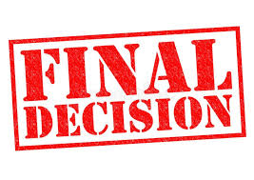


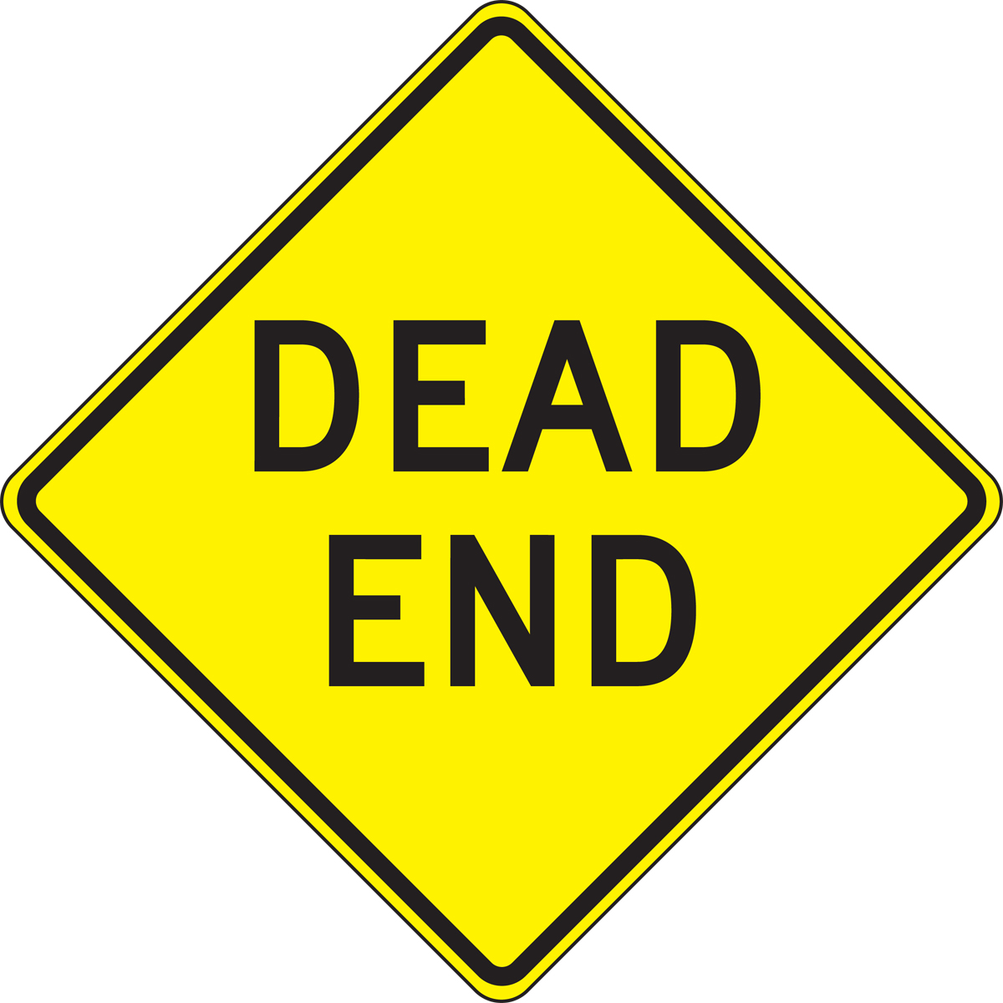
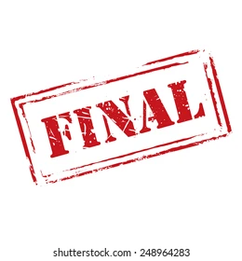
BE PREPARED TO LIVE WITH THE OUTCOME
U.S. Trinity Energy Services v. Southwest Directional Drilling - 2025 CA5 case in which the Court held that “manifest disregard of the law” is not a valid basis for vacatur and could not be used as “a backdoor for a party to seek judicial review of the arbitrator’s interpretations.” “[T]he statutory grounds are the exclusive means for vacatur under the FAA:”
  where the award was procured by corruption, fraud, or undue means;
  where there was evident partiality or corruption in the arbitrators, or either of them;
  where the arbitrators were guilty of misconduct in refusing to postpone the hearing, upon sufficient cause shown, or in refusing to hear evidence pertinent and material to the controversy; or of any other misbehavior by which the rights of any party have been prejudiced; or
  where the arbitrators exceeded their powers, or so imperfectly executed them that a mutual, final, and definite award upon the subject matter submitted was not made.

